Slide 1

Dr. AMBEDKAR INSTITUTE OF TECHNOLOGY (An Autonomous Institute, Affiliated to VTU, Belagavi, BANGALORE – 560056)
DEPT OF COMPUTER SCIENCE AND ENGINEERING
DATABASE MANAGEMENT SYSTEM
21CST503
GROUP ACTIVITY
TOPIC: HOTEL MANAGEMENT SYSTEM
SUBMITTED BY:
CHETHANA S MURTHY(1DA21CS180)
KEERTHI B S(1DA21CS182) SUBMITTED TO:
Veena Potdar
(Assistant professor , dept
of cse engg , Dr Ait)

Slide 2

HOTEL MANAGEMENT SYSTEM

Slide 3
CONTENT:
Software Requirements.
Hotel Management Database.
Attributes of Tables
ER Diagram
Schema Diagram
Frontend
Case Study
Conclusion

Slide 4
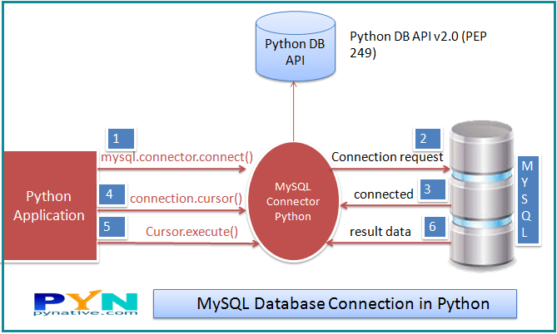
SOFTWARES USED:
Software used is visual studio code(VS code) and MySql .
Fronted as “Python”.
Backend as “Database”.

Slide 5
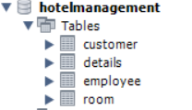
HOTELMANAGEMENT DATABASE
Schema created is hotelmanagement .
Tables created are:
Customer
Room
Employee
Details

Slide 6
Attributes of Each Table:
Customer:
• Ref: Every customer has an id. It is of the type varchar.
• Name: Every customer has name to be identified differently. It is of the type varchar.
• Address: Every customer has an address on where they stay. It is of the type text.
• Mobile: Every customer has a phone no. through which they can be contacted.It is of the type int
Ref | Name | Father | gender | postcode | mobile | email | nationality | IdProof | Id_no | addr

Slide 7
Room:
Contact: it is used fetch the data of the customer. It is type of number.
Check_in: it is a type of date.
Check_out: it is a type of date.
Roomtype: it is a checkbox used know the type of room.
Meal: it is a type of varchar.
Details:
Floor: it contains floor number of room. It is a type of number.
Roomtype: it is type of varchar.
Room_no: it is used to know the room no.
contact | check_in | check_out | roomtype | room | meal | noOfdays
floor | roomtype | Room_no

Slide 8
Employee:
• Emp_id: Every customer has an id. It is of the type varchar.
• Name: Every customer has name to be identified differently. It is of the type varchar.
• Address: Every customer has an address on where they stay. It is of the type text.
• Mobile: Every customer has a phone no. through which they can be contacted.It is of the type int
Login:
Name: Entering the username. It is of the type varchar.
Email: Email address of the username is of type varchar.
Contact: Contact number of the user is of type varchar.
Security key: Security key containing questions. It is of the type varchar.
Security answer: Security answer is present. It is of the type varchar.
Password: Password should be set for security purpose. It is of the type varchar.
Emp_id | name | father | gender | mobile | email | salary | jobdesc | idproof | Id_no | address

Slide 9
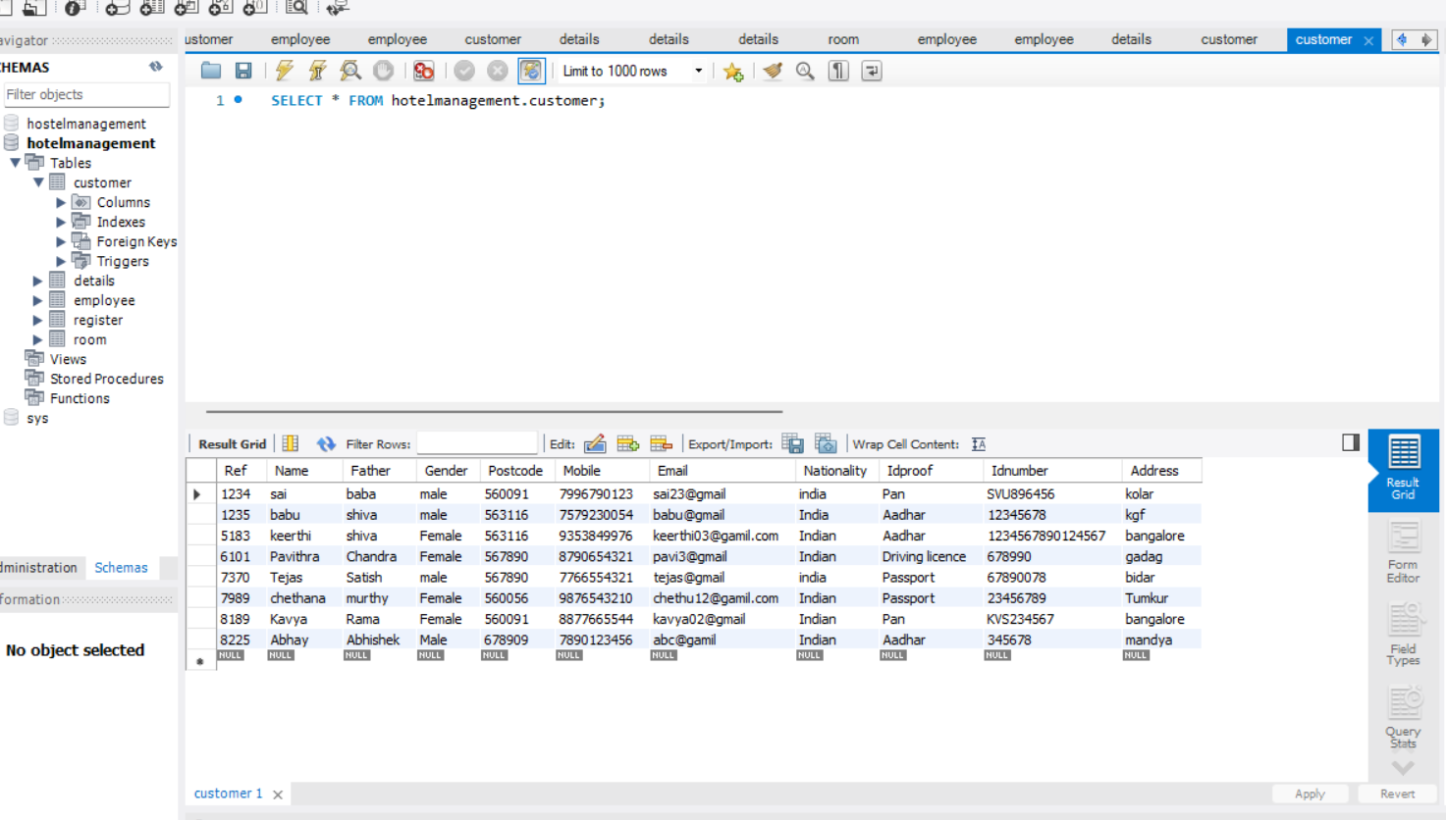

Slide 10
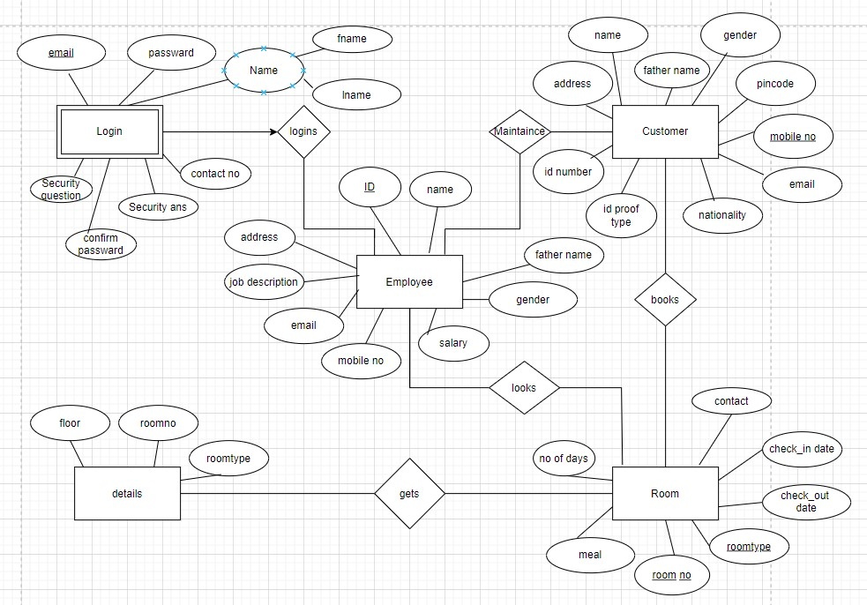
ER DIAGRAM

Slide 11

Schema Diagram:
fname | lname | email | Security qn | Security ans | contact | Password | Confirm password

Slide 12
FRONTEND:
Python is used for frontend.
Some import models used in the project are
Tkinter : used to construct basic graphical user interface application.
MySql connector : it is used to connect the frontend with backend database.
Fronted is used to create the Menu i.e Home page , Customer page ,Room page ,Details page , Employee page.
Home page contains the button of customer , room ,Details , Employee
And all these are cloned to access the above pages.
All the tables of database is connect to frontend through mySql connector.

Slide 13
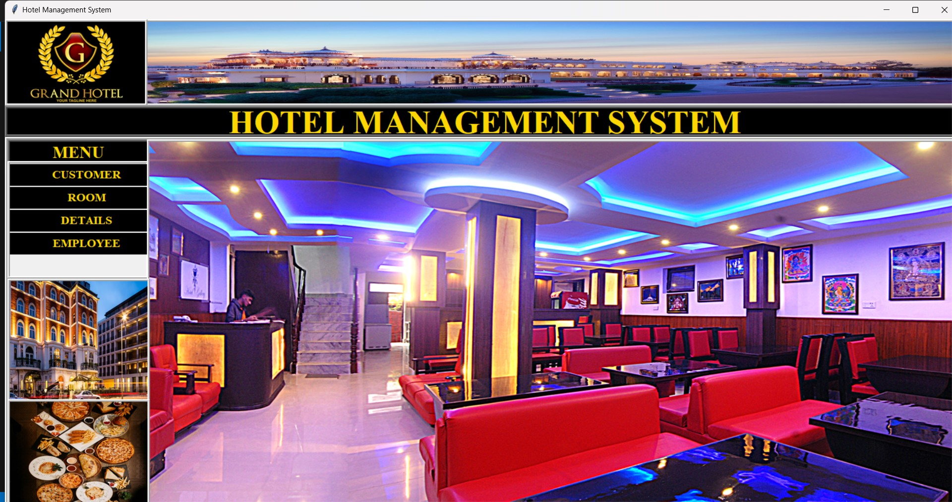

Slide 14
CASE STUDY
The hotel management system.
It has the features or crud operations like Add , Update , Reset , Delete , fetch , Search , showall .
Update is used to modify the data that already exist.
Add is used to add the customer data , room details , employee data.
Reset is used to set.
Delete is used to delete the data.
Fetch is used to get the data from tables of database.
Search is used to search the data using mobile number or room no .

Slide 15
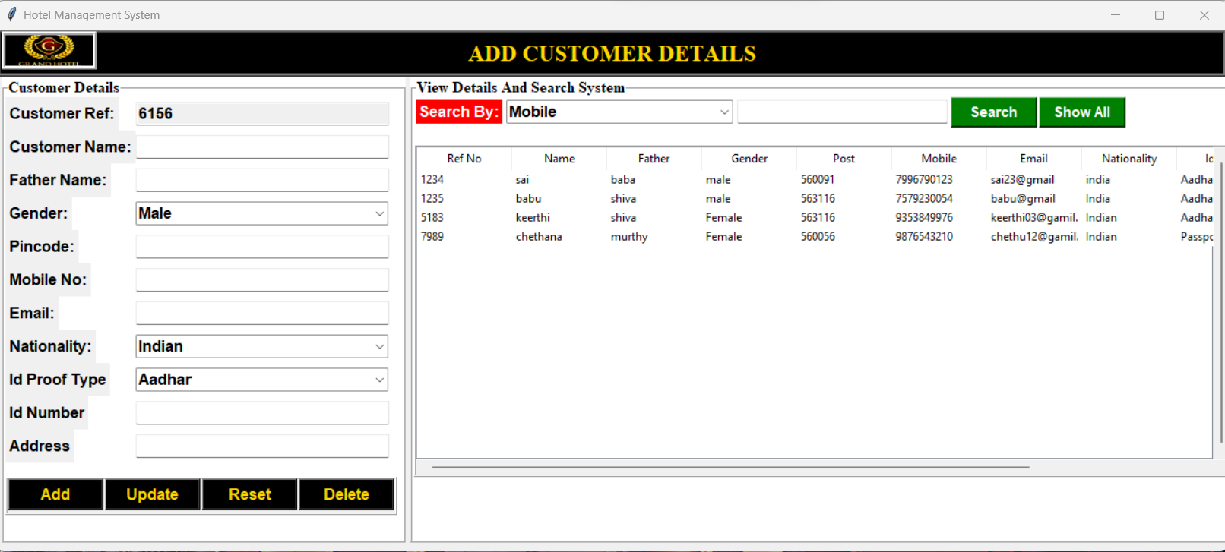

Slide 16
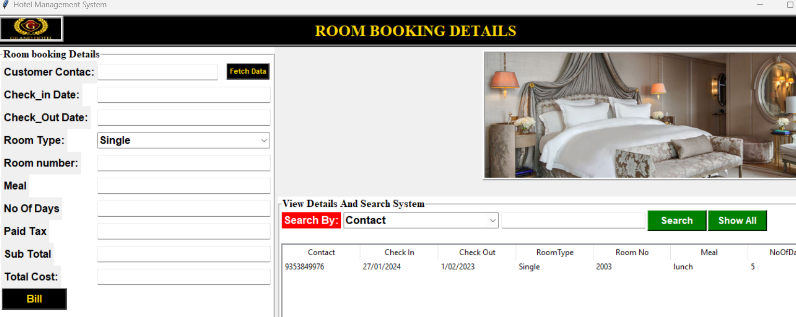

Slide 17
CONCLUSION
By doing these project we have upskilled our knowledge .
Modern technical skills like Python , Mysql .
The connection is made between frontend and backend.
Working in team.

